Slide 1
06th October 2023
Sofia Belloni – s303393
Vittoria Civiero – s302839
Ilaria Panuccio – s302677
Alessandro De Marco – s317626
MACHINE LEARNING IN APPLICATION:
PROJECT 01-FP04
GLOMERULI DETECTION

Slide 2
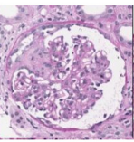
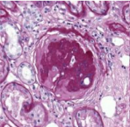
Introduction & Background I
Glomeruli: clusters of capillares located in the kidneys
First filtering step --> balance of body fluids and removal of waste
Glomeruloslerosis: condition in which the glomerulus is injured and scarred
Identification and quantification of the sclerosed glomeruli
Diagnosis of the patient's pathology
Disadvantages: tedius and time consuming
NORMAL
SCLEROSED
1

Slide 3
Introduction & Background II
Challenges:
High dimensionality dataset --> division into patches of small size
--> Legion platform
Imbalanced dataset --> majority class reduction
--> data augmentation of glomeruli images
Unavailability of labels for glomeruli classification --> feaure extraction
--> unsupervised classification
2

Slide 4
Introduction & Background III
Glomeruli
identification
SEMANTIC SEGMENTATION
SegNet
U-Net
Glomeruli
classification
2. FEATURES
EXTRACTION
3. DIMENSIONALITY REDUCTION
4. CLUSTERING
VGG19
ResNet50
Isomap
t-SNE
K-means
Autoencoder
3

Slide 5
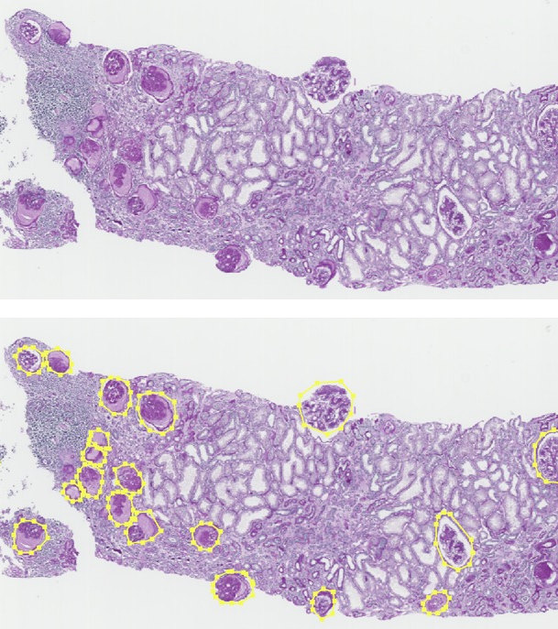
Materials & Preprocessing I
9 WSIs of human kidney tissue
Patches 2000x2000
Overlap technique
Filtration
Resizing into 512x512 pixels
7271 images whose 3154 containing glomeruli
Binary Mask
4

Slide 6
Materials & Preprocessing II
Balancing
8367 samples obtained
Splitting
Training Set 70%
Validation Set 20%
Test Set 10%
Data Augmentation on the Training Set
Affine transformations: flip, rotation, crop and local distortion
Color transformations: dropout, brigthness, grayscale and gammacontrast
The majority class was halved while the minority class was doubled through some simple transformations: vertical and horizontal rotation and contrast mutation
23424 images in the training set
5

Slide 7
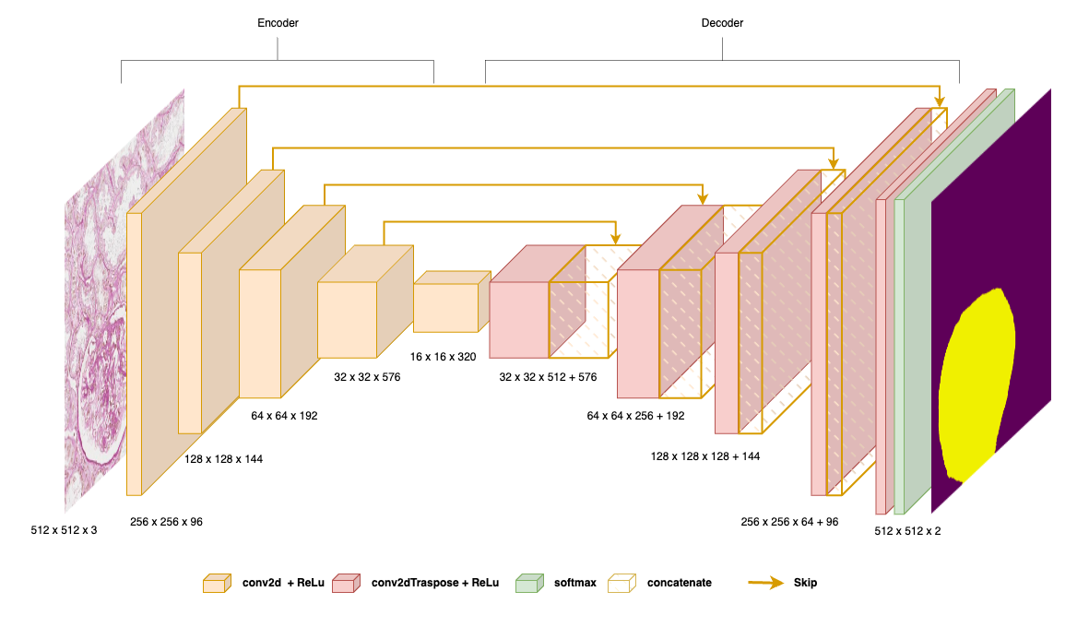
U-Net
Input
Encoder
Decoder
5 deconvolutional blocks (Cond2DTranspose, upReLU activation function)
4 skip connections
Softmax
Output
5 convolutional blocks (Conv2D, Batch Normalization, ReLU activation function)
It computes pixel-wise classification scores
It shows the predicted pixel map composed of two channels
Skip layers
Images of size 512x512x3
6

Slide 8
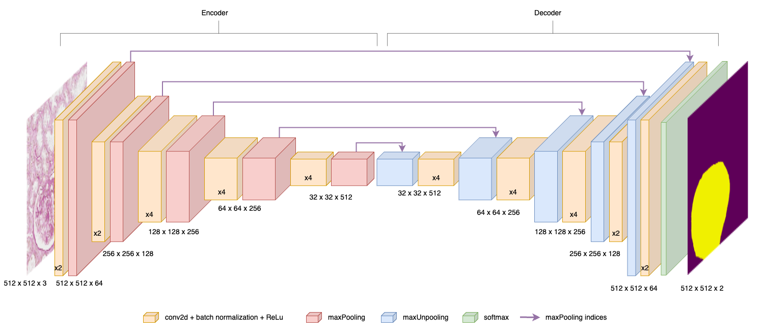
SegNet
Input
The input layer accepts RGB images of size 512x512
Encoder
5 convolutional blocks
Decoder
5 deconvolutional blocks
Batch normalization
ReLU activation function
Max pooling with Arg
Conv2D
Max unpooling with Arg
Conv2D
Batch normalizzation
ReLU activation function
Max Pooling indices
Skip layers employ max pooling to downsample features, capturing the max indices, and then use max unpooling with these indices to precisely restore spatial resolution during the upsampling process
Softmax
It computes pixel wise classification scores
Output
It shows the predicted pixel map composed by two channels
7

Slide 9
SegNet vs U-Net
SegNet
VGG19
U-Net
MobileNetV2
4 skip layers
5 Max pooling and Max unpooling layers with indices
More complex architecture:
It is slower
it achieves better results
Simpler architecture:
It is faster
it achieves worse results
8

Slide 10
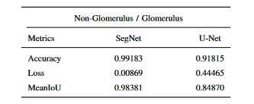
Evaluation Metrics
Goal:
Use metrics to evaluate semantic segmentation performances.
Results:
Accuracy: close to 1;
Loss: close to 0;
MeanIoU: close to 1.
Both methodologies produce predictions really similar to the ground truth but SegNet seems to perform slightly better than U-Net.
9

Slide 11
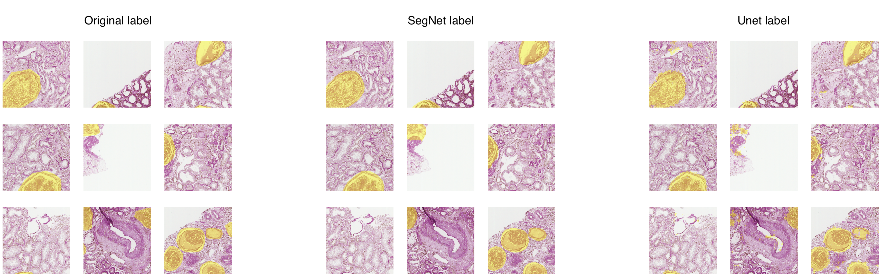
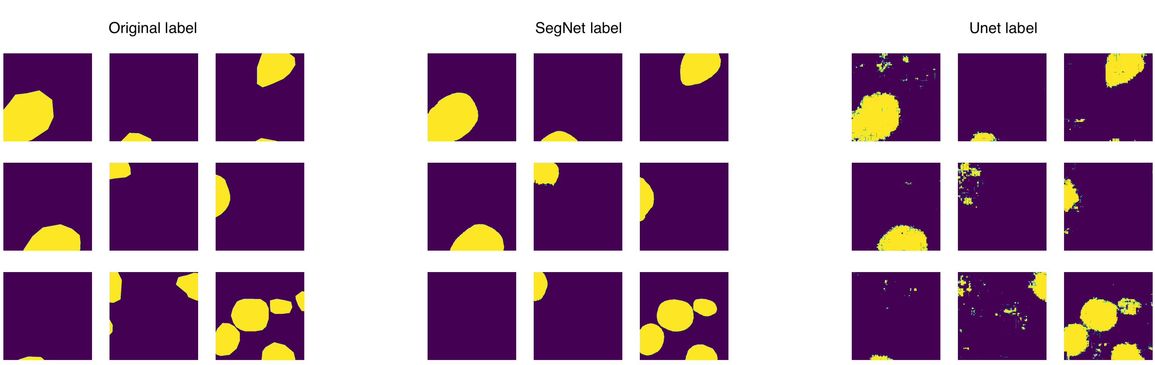
Semantic Segmentation Results
10

Slide 12
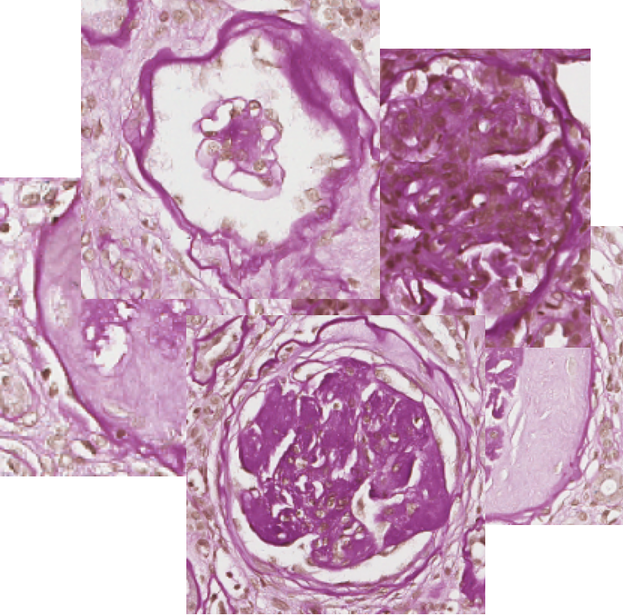
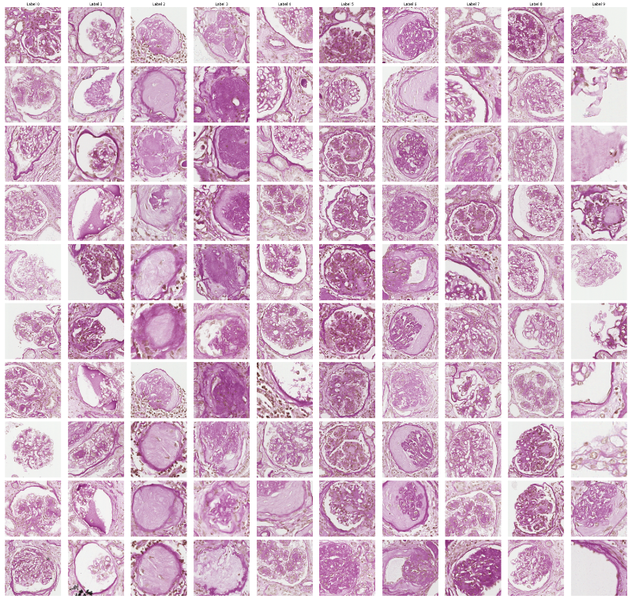

Clustering pipeline
2511 images for training 885 images for test
Autoencoder
512 features for each image in test set
VGG19
512 features for each image in test set
Resnet50
2048 features for each image nel test set
Training
Fine Tuning
Fine Tuning
K-means
Isomap + K-means
Clusters
t-SNE+ K-means
11

Slide 13
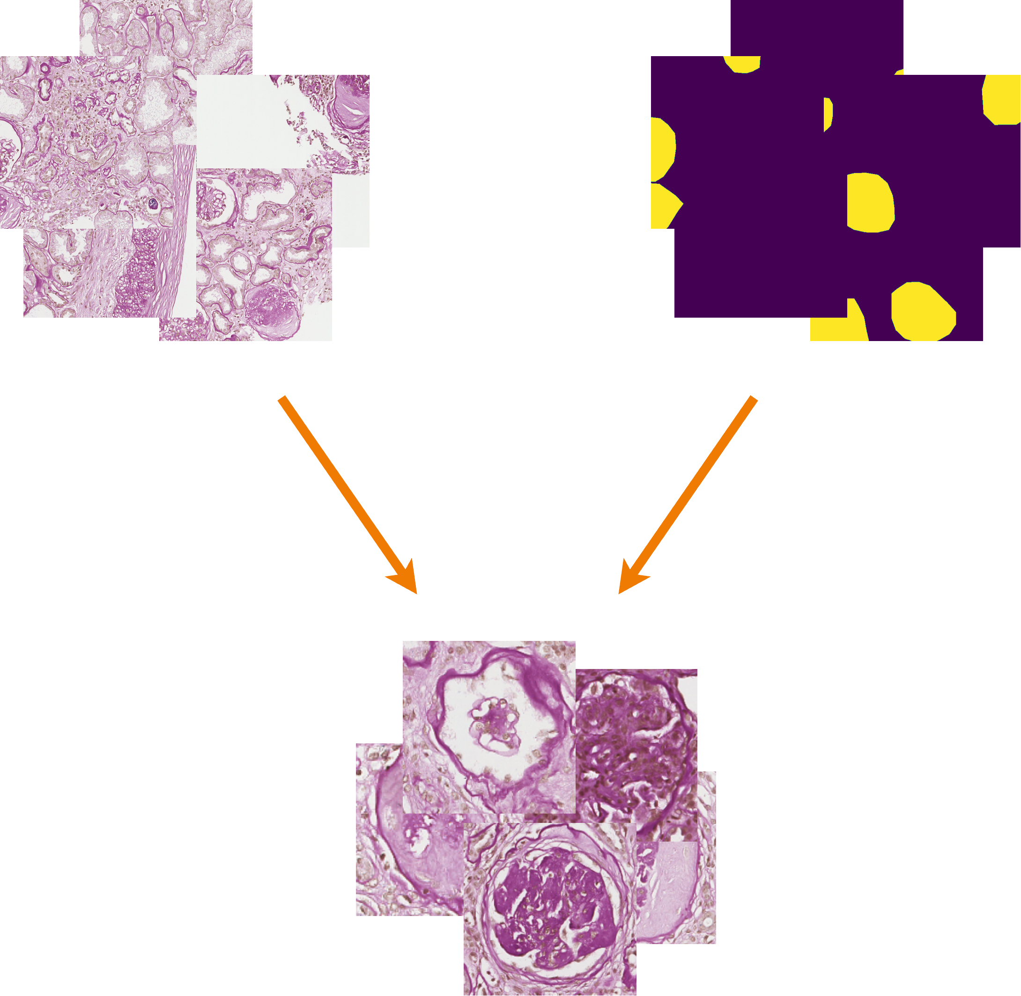
Dataset Construction
Initial set: 7271 images with semantic segmentations
Selected 3154 images containing glomeruli
Extracted squares from all identified glomeruli in segmentations
Discarded glomeruli smaller than 20x20 pixels
Filtered images with less than 60% glomerulus-class pixels
Result: 1702 glomerulus images
Applied basic augmentation: vertical/horizontal rotations and mild contrast adjustments
Dataset split: 75% training (2511 images for autoencoder) and 25% testing (885 images).
12

Slide 14
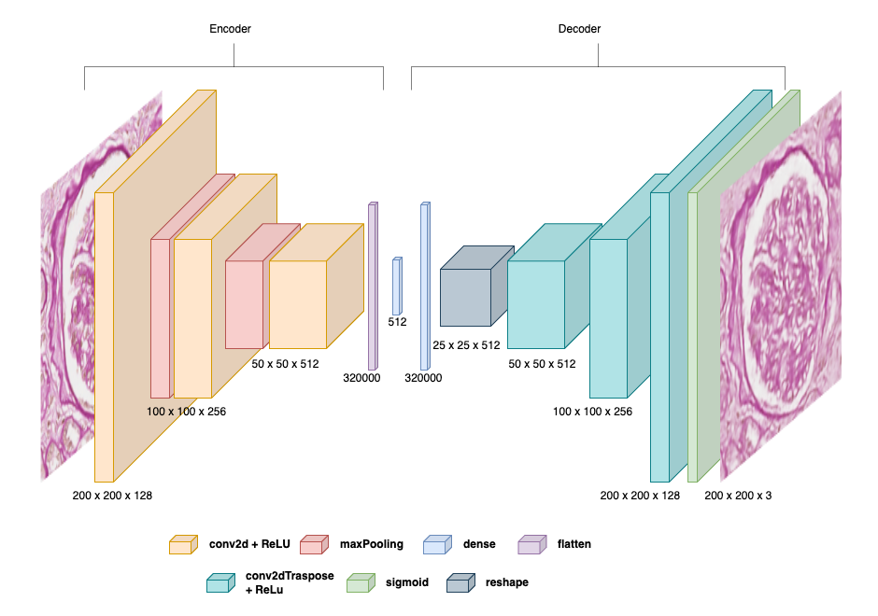
Feature extraction - Autoencoder
Input
Output
Encoder
Decoder
Latent space
The input layer accepts RGB glomeruli images of size 200x200
Convolutiolnal blocks
Dense layer with 512 neuron
3 Deconvolutional blocks
Reconstruction of the original image
ReLU Activation Function
Conv2D
Max pooling
Conv2DTraspose
ReLU Activation function
13

Slide 15
Feature extraction - VGG19
Deep CNN with 19 layers (16 convolutional + 3 fully connected)
16 convolutional layers divided in 5 blocks:
Dimension 2x2
Stride 2
Block 1:
2 convolutional layers
64 kernels, 3x3
Block 3:
4 convolutional layers
256 kernels, 3x3
Block 5:
4 convolutional layers
512 kernels, 3x3
MaxPooling
MaxPooling
MaxPooling
MaxPooling
MaxPooling
Block 2:
2 convolutional layers
128 kernels, 3x3
Block 4:
4 convolutional layers
512 kernels, 3x3
3 fully connected layers
Stride 1
Padding 1
512 features
extracted
14

Slide 16
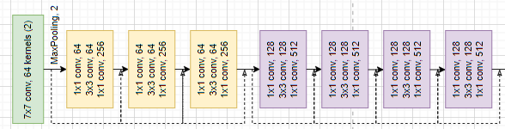
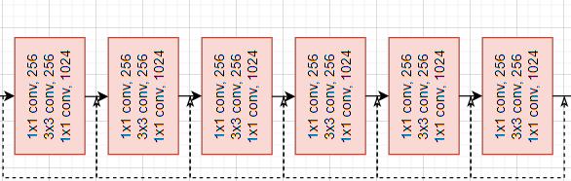
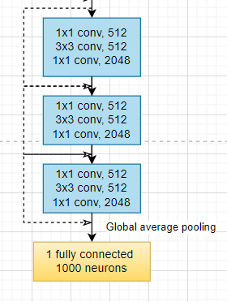
Feature extraction - ResNet50
Deep CNN with 50 layers
64 kernels 1x1
64 kernels 3x3
256 kernels 1x1
128 kernels 1x1
128 kernels 3x3
512 kernels 1x1
256 kernels 1x1
256 kernels 3x3
1024 kernels 1x1
512 kernels 1x1
512 kernels 3x3
2048 kernels 1x1
Skip connection
2048 features
extracted
Global average pooling
15
Notes:
https://blog.devgenius.io/resnet50-6b42934db431

Slide 17
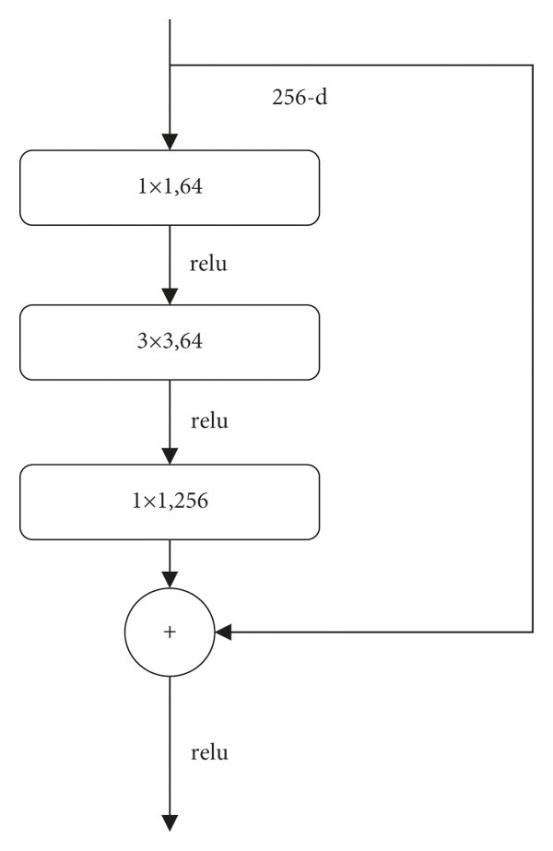
Feature extraction - ResNet50
Residual blocks
The input follows a path called skip connection and it is added directly to the block's output
Mitigate the "disappearance/ exploiding of the gradient " problem
Allow to learn the identity
Performance improvement
16

Slide 18
Nonlinear dimensionality reduction
Goal: discover the underlying structure, or manifold, of the data and represent it in a lower-dimensional space while preserving important relationships and patterns
ISOMAP: aims to find a low-dimensional representation of data that preserves the geodesic distances between points in the high-dimensional dataset
t-SNE: measures similarity between high-dimensional points using a probability distribution based on a t-distribution
17

Slide 19
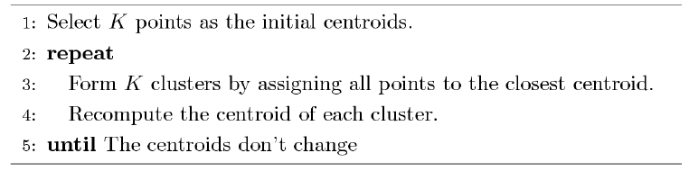
Clustering (I)
Goal: Classify glomeruli based on their respective sclerosis statuses
K-MEANS
Partitional clustering approach
Number of clusters, K, must be specified
Partitions a set of data points into homogeneous groups (clusters) based on their similarity
Complexity: O( n * K * i * d )
n = number of points, K = number of clusters,
i = number of iterations, d = number of attributes
18

Slide 20
Clustering (II)
Features extracted through Autoencoder, VGG-19, ResNet-50
K-means clustering algorithm was applied:
Directly to the previously obtained features;
To the features reduced through Isomap;
To the features reduced through t-SNE.
The optimal value of k was identified using the grid search approach.
K-means' results are evaluated through different evaluation metrics
19

Slide 21
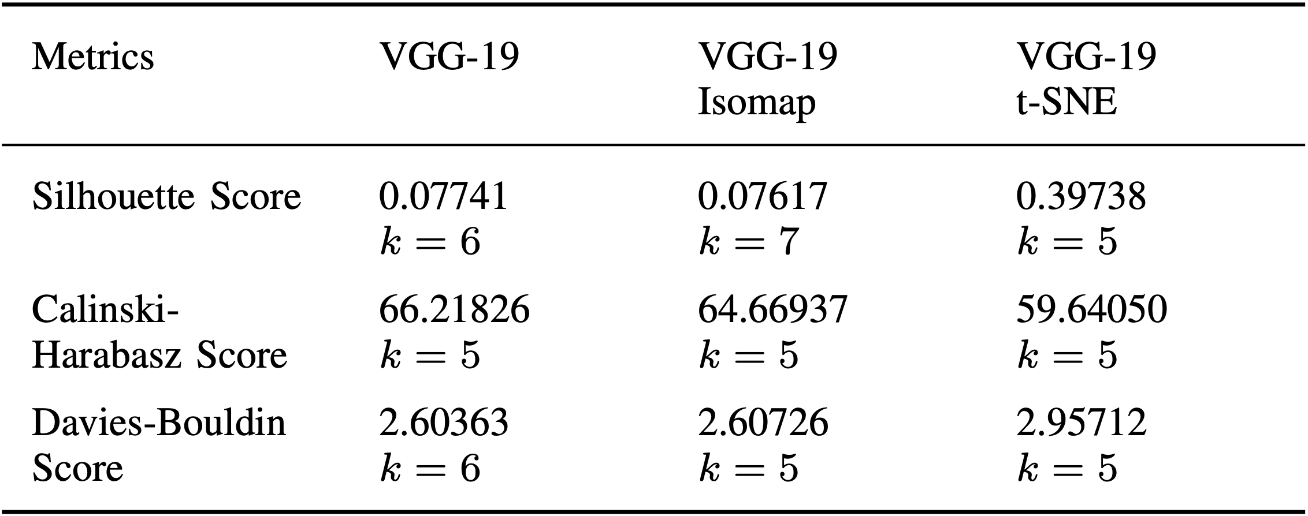
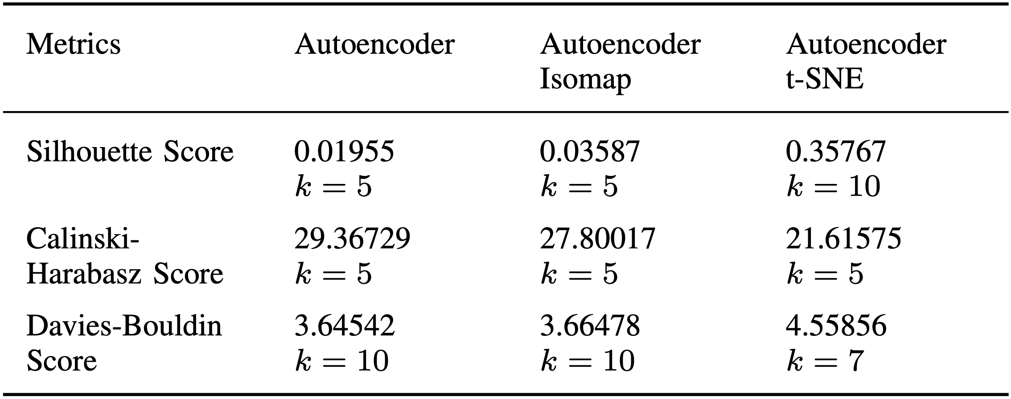
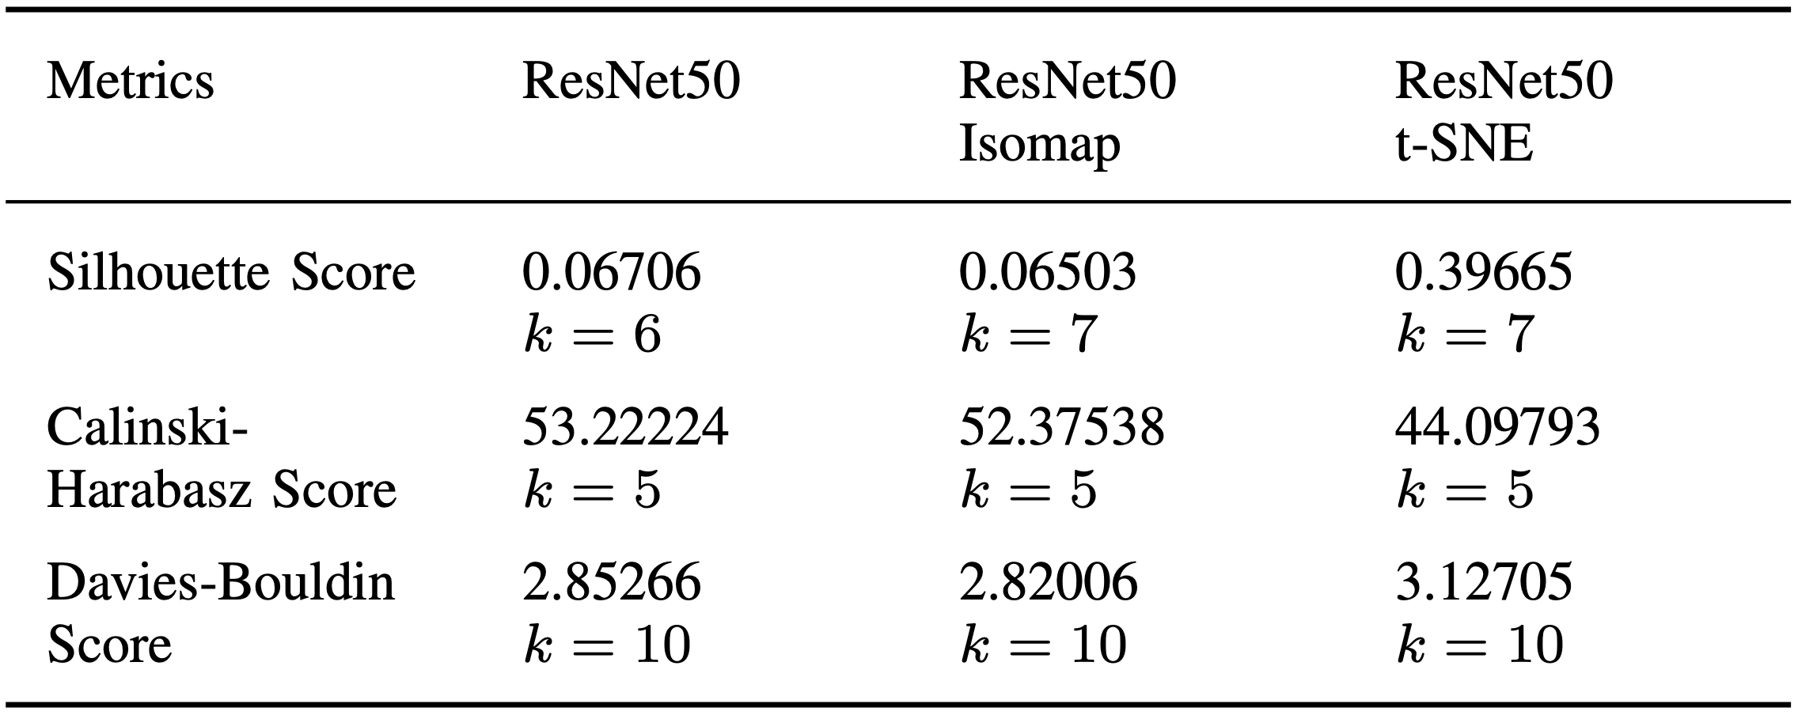
Evaluation metrics
Goals:
Identify the optimal number of clusters k
Measure the 'goodness' of the clustering
structure
20

Slide 22
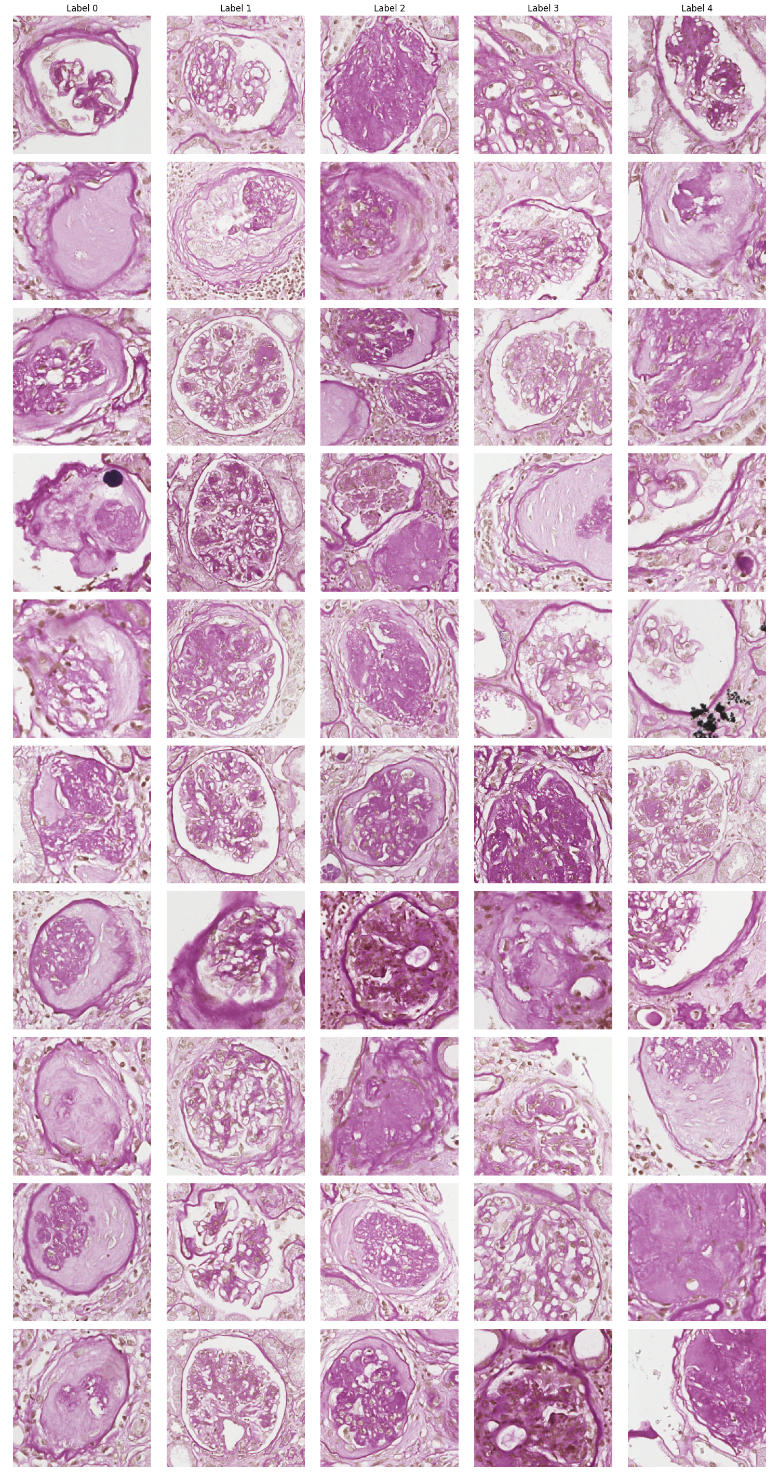
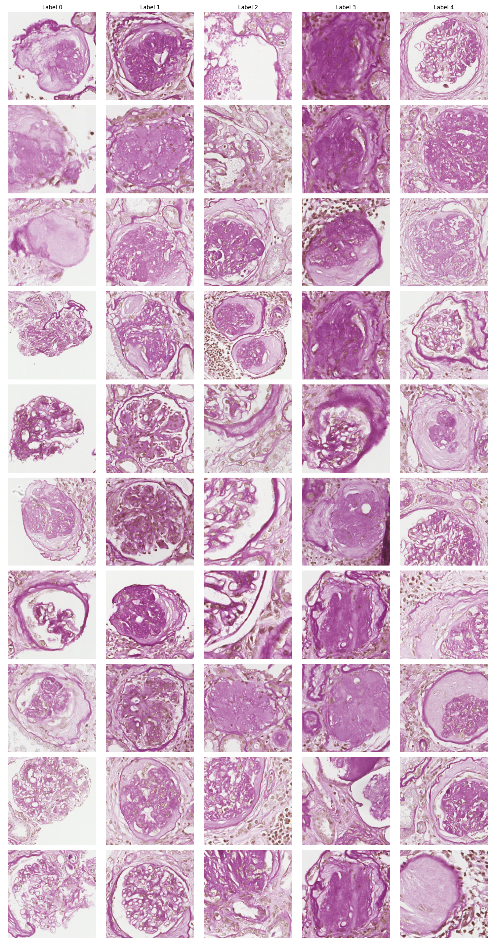
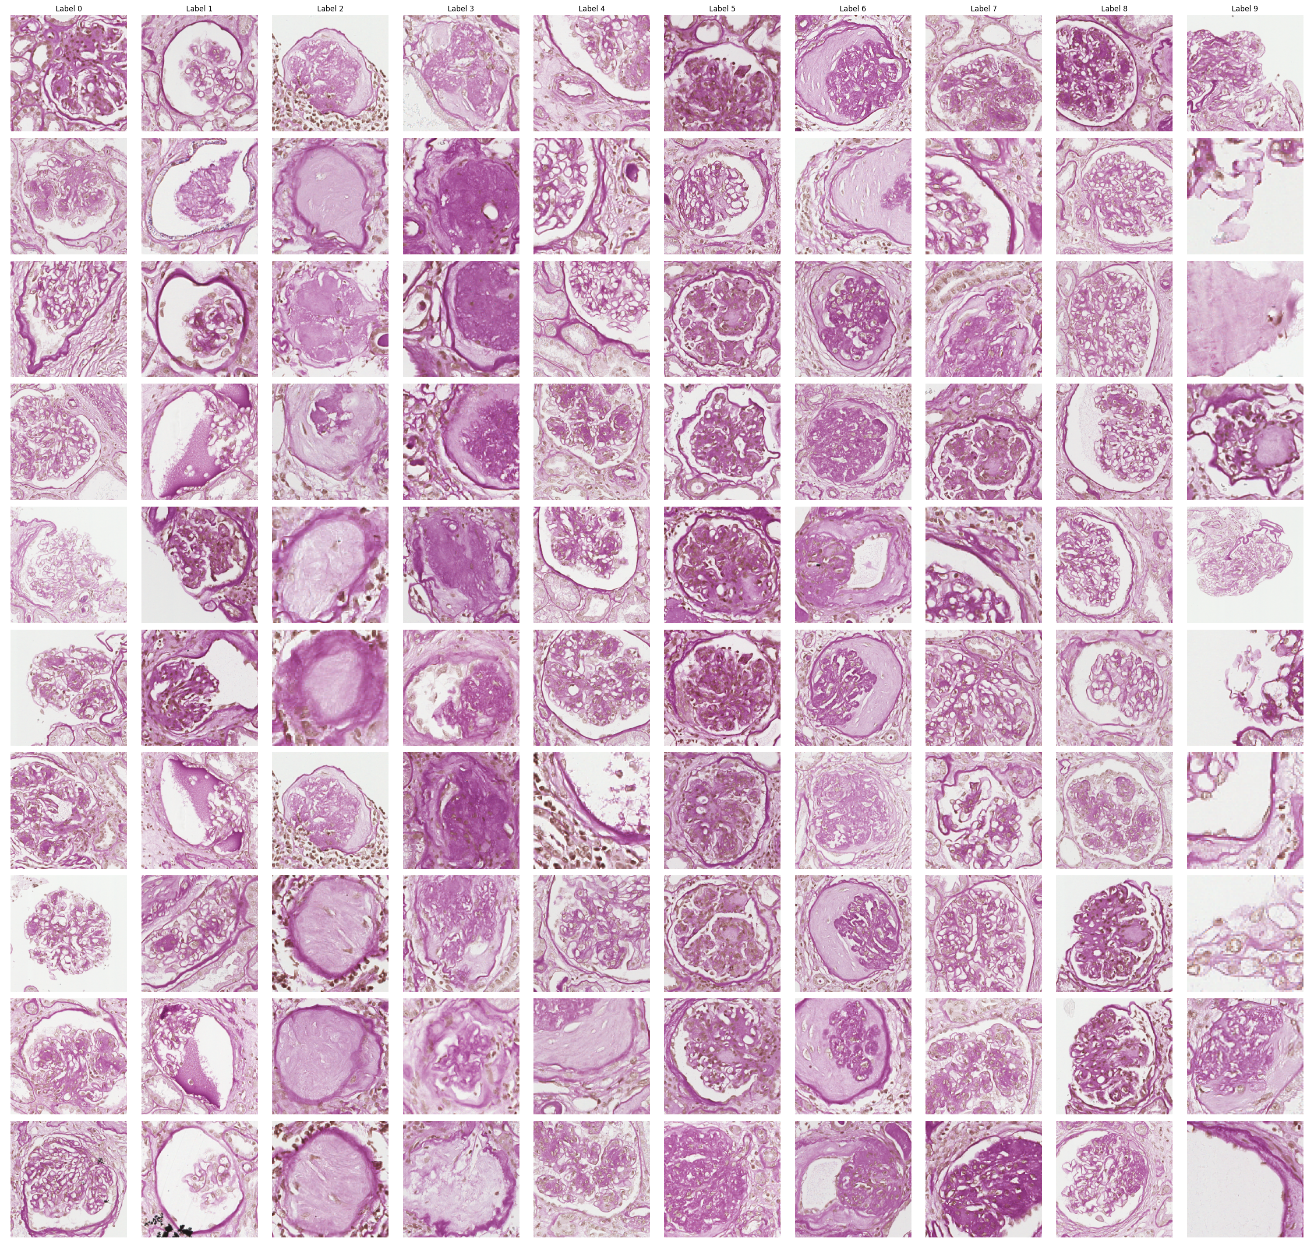
Results
Images from K-means (CH score) applied to VGG-19 features
Images from K-means (DB score) applied to ResNet50 features
Images from K-means (silhouette score) applied to autoencoder features reduced throw is isomap
21

Slide 23
Conclusions
Semantic segmentation
SegNet has slightly better results than U-Net
Both models lead to good results
Classification
K-means doesn't provide comfortable results, despite the feature extraction
The lack of a ground truth has been detrimental to the classification of such complex images
Future work
Collaboration with a pathologist who can evaluate our cluster results / assign the correct labels to sclerosing glomeruli and consequently the application of supervised classification models
22
Notes:
Modifica patologo che può sia valutare I cluster, sia assegnare le label

Slide 24
Alessandro De Marco, Sofia Belloni,
Vittoria Civiero, Ilaria Panuccio
Machine learning in application – 2022/2023
Project 01-FP4
THANKS FOR YOUR
ATTENTION!

Slide 25
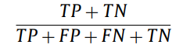
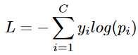
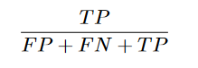
Appendix A- Evaluation metrics
Metric | Description | Values used | Formula
Accuracy | It represents the proportion of correct predictions. A higher accuracy indicates better results, with a maximum value of 1 indicating that all predictions are correct. | TP true positive; TN true negative; FP false positive; FN false negative
Loss | It measures the distance between the ”true” distribution and the distribution predicted by the mode. | C is the total number of classes; yi is 1 if the class is the ground truth and 0 otherwise; pi is the predicted probability that the instance belongs to class i.
MeanIoU | It computes the amount of overlapping between the predicted segmentations and the ground truth across all classes. It consists of the ratio of the intersection (correctly predicted pixels) to the union (total pixels belonging to that class in either the prediction or ground truth) of the segmented area. | TP true positive; FP false positive; FN false negative
Notes:
Metriche che guardano aspetti diversi e non sono ridondanti

Slide 26
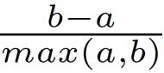
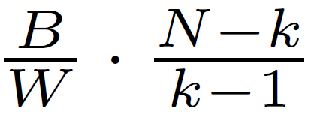
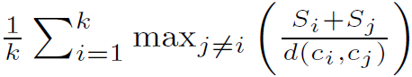
Appendix B - Evaluation metrics
Metric | Description | Values used | Formula
Silhouette Score | Evaluate how well-separated the clusters are and how similar the data points within each cluster are to each other. Range [-1; +1] | a is the mean intra-cluster distance; b is the mean nearest-cluster distance
Calinski-Harabasz Score | Measure of cluster separation or compactness. Higher CH score indicates better-defined, well-separated clusters | B is the intra-cluster variance; W is the inter-cluster variance; N is the total number of data; k is the number of clusters
Davies-Bouldin Score | Measure the average similarity between each cluster and its most similar cluster, relative to the size of the clusters. Lower DB score indicates better clustering. | k is the number of clusters; S_{i} is the inter-cluster variance; d(c_{i},c_{j}) is the distance between the centers of cluster i and j

Slide 27
Appendix C Autoencoder vs VGG19 vs ResNet50
Autoencoder
Encodes data in an unsupervised way
Exploit the latent space as features map
Convolutional blocks with increasing depth
MaxPooling
512 features extracted
VGG19
Supervised feature extraction
19 convolutional layers
Uniform anchitecture
Gradually increasing complexity
high learning ability
MaxPooling
High number of parameters
overfitting
512 features extracted
ResNet50
Supervised feature extraction
50 convolutional layers
Convolutional blocks with different sizes alternate
Skip connections
Global average pooling
no overfitting
2048 features extracted
Notes:
reduction of spatial information
extraction of higher level features in successive stage

Slide 28
Appendix D Feature extraction - VGG19
Peculiarities:
Each kernel has size 3x3
Each layer has stride 1 and padding 1
MaxPooling has dimension 2x2 and stride 2
Complexity increasing gradually with the increasing number of kernels
Disadvantages:
Increasing of complexity --> increasing of parameters
UNIFORM ARCHITECTURE
HIGH LEARNING ABILITY
OVERFITTING

